Slide 1
Data Visualization 2
Introduction to Data Visualization with Python
Session 1

Slide 2
Housekeeping
Please be informed that the lectures of thecourse will be recorded by the Department of Economics and Business and shared via Moodle where you and all other participants of the course can watch it until the end of the semester. After that date the recording will be deleted. During the recording your image or voice might be recorded. The Department of Economics and Business publishes the recording of the lecture with no modifications.

Slide 3
About us

Slide 4


Bence ARATÓ
Managing director @ BI Consulting
Met with BI first in 1995 as a college student
Founded 4 companies in the data/analytics field
Organizer of the PyData Budapest meetup
Email: AratoB@ceu.edu
Bence CZIBULYA
BI Consultant and developer @ BI Consulting
Has a degree in Software Engineering
Python enthusiast
Email: CzibulyaB@ceu.edu

Slide 5
About the course

Slide 6
About the course
Goal
Provide an overview of the Python data visualization landscape
Provide hands-on introduction to Plotly, a leading Python dataviz package using JupyterLab
Schedule
Course is 1 credit, 2 sessions of 3x100 minutes
November 2 (Thursday) and November 8 (Wednesday)
13:30-15:10
15:40-17:20
17:40-19:20

Slide 7
Grading
After the last session, every student will create a data visualization project in Python
The project consists of a JupyterLab notebook
Code, charts and documentation in one place
Naming and sharing instructions will be provided in Session 2
The tasks typically include
Selecting a dataset
Loading, cleaning and transforming data as needed
Creating a few chart types and combining them into a dashboard
Applying data visualization best practices (layout, formatting, labeling etc.)

Slide 8
About the class

Slide 9
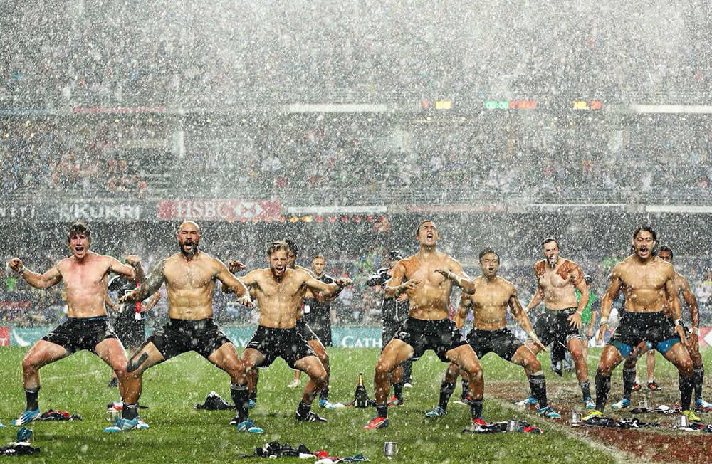
About the class
Notes:
How many charts do we know?
And how many types are we actively using?

Slide 10
About the class
Dataviz background
Programming background
Python background
Notebook experience (Jupyter/Colab/Kaggle)

Slide 11
How to visualize data in Python?

Slide 12
Dataviz in Python
Python has many data visualization tools
Maybe too many ☺
You can think of the main categories as
Classic or „old school” dataviz tools (e.g matplotlib)
Modern dataviz libraries (plotly, altair, holoviz)
Special libraries for people already familiar with dataviz in other languages / frameworks (e.g plotnine for R/ggplot2 users)
There are 3 layers
Low-level charting libraries – main goal is functionality
High-level charting libraries – main goal is ease of use
Dashboarding libraries – assembling charts into interactive apps

Slide 13
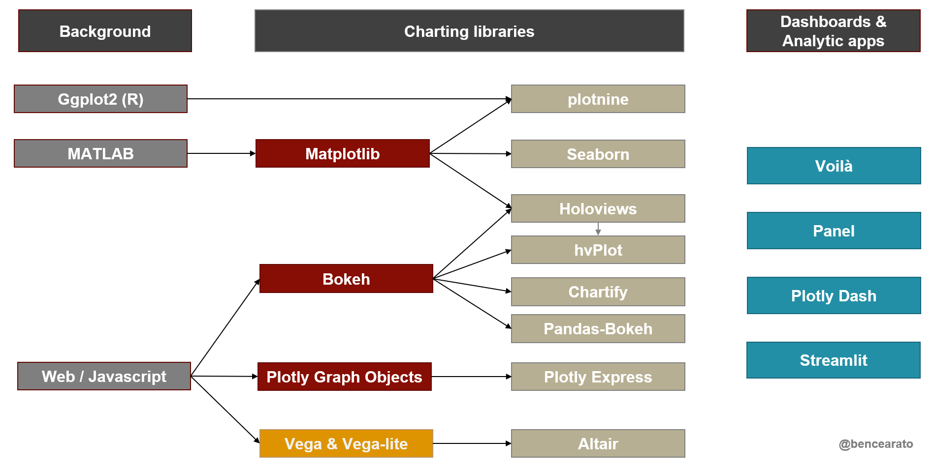
Dataviz in Python

Slide 14
Ploty Express hands-on

Slide 15
Thank You

